Slide 1
Chapter 3
Age and Acquisition

Slide 2
Q:
Discussion topics (p.52)

Slide 3
Q:
Explain Critical Period Hypothesis (p.54)

Slide 4
Brain lateralization
The left brain does not want the student to take risks because the person may make a mistake. The right brain, for comparison, encourages playfulness without fear. The right brain tells the student: “Take a chance!. You won’t go to jail! Enjoy it! Just start doodling in this new language.”

Slide 5
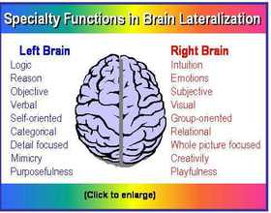
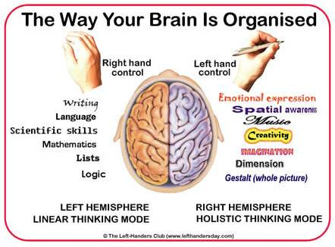
Hemispheric lateralization (p.55)
Issues
When does lateralization take place?
Does it affect language acquisition? (p.56-57)

Slide 6
Q:
Is achieving native-like accent significant in L2 acquisition? (p.59)

Slide 7
Q:
Are children better language learners than adults? Why? Why not? (p.61-63)

Slide 8
Q:
Explain the affective domain in SLA
(p.63-65)

Slide 9
Types of bilingualism
Early bilingualism –
Simultaneous early bilingualism refers to a child who learns two languages at the same time, from birth.
Successive early bilingualism refers to a child who has already partially acquired a first language and then learns a second language early in childhood
Late bilingualism
It refers to bilingualism when the second language is learned after the age of 6 or 7; Late bilingualism is a consecutive bilingualism which occurs after the acquisition of the first language.

Slide 10
Additive bilingualism vs. subtractive bilingualism
The additive bilingualism refers to the situation where a person has acquired the two languages in a balanced manner
Subtractive bilingualism refers to the situation where a person learns the second language to the detriment of the first language, especially if the first language is a minority language

Slide 11
The coordinate bilingual has two sets of concepts and two lexicons connected to them.
The compound bilingual has one set of conceptions and two lexicons connected to them.
The sub-coordinate bilingual has a primary set of meaning established through their first language, and another linguistic system attached to them.

Slide 12
Q:
Does L2 acquisition follow the same order of L1 acquisition? (p.67)
Five determinants of acquisition order (p.68)

Slide 13
Q:
What are the ‘age and acquisition’ inspired teaching methods? (p.73)

Slide 14
Discussion topics
Does your L1 interfere your L2?
When?

