Slide 1
Genres
Genre | Purpose | Activities
Descriptive Writing | Students observe carefully and choose precise language. They take notice of sensory details and create comparisons (metaphors and similes) to make their writing more powerful. | Character sketches Descriptive essays Descriptive sentences
Expository Writing | Students collect and synthesize information. This writing is objective; reports are the most common type. Students use expository writing to give directions, sequence steps, compare one thing to another, explain causes and effects, or describe problems and solutions. | Directions Posters Reports Summaries

Slide 2
Journals and Letters | Students write to themselves and to specific, known audiences. Their writing is personal and often less formal than other genres. Students learn the special formatting that letters and envelopes require. | Business letters Courtesy letters E-mail messages Friendly letters Personal journals
Narrative Writing | Students retell familiar stories, develop sequels for stories they have read, write stories about events in their own lives, and create original stories. They include a beginning, middle, and end in the narratives to develop the plot and characters. | Original short stories Personal narratives Retellings of stories Sequels to stories

Slide 3
Persuasive Writing | Persuasion is winning someone to your viewpoint or cause using appeals to logic, moral character, and emotion. Students present their position clearly and support it with examples and evidence. | Advertisements Book and movie reviews Letters to the editor Persuasive essays Persuasive letters
Poetry Writing | Students create word pictures and play with rhyme and other stylistic devices as they create poems. Through their wordplay, students learn that poetic language is vivid and powerful but concise and that poems can be arranged in different ways on a page. | Acrostic poems Color poems Poems for two voices

Slide 4
Writing process
Prewriting
2. Drafting
3. Revising

Slide 5
Prewriting: Engaging in activities that generate ideas, including reading, brainstorming, free writing, clustering, creating tree diagrams or flow charts, drawing, dramatizing or role-playing, engaging in chat.

Slide 6
Planning:
Designing structure and content of the text.

Slide 7
Drafting:
Composing text.

Slide 8
Revising:
Re-seeing or re-envisioning the whole text
by adding or deleting content, changing the
order of presentation, making major stylistic
changes, etc.

Slide 9
Editing & proofreading:
Making changes at the local, or sentence,
level, including changing word choice and sentence structure as well as correcting any errors

Slide 10
Publishing:
Formatting, producing, and distributing
the revised text, including possibilities like
presenting an individual portfolio, publishin
a class book, creating a Webpage, etc., as
well as simply turning a finished text in to a
teacher.

Slide 11
Writing activities

Slide 12
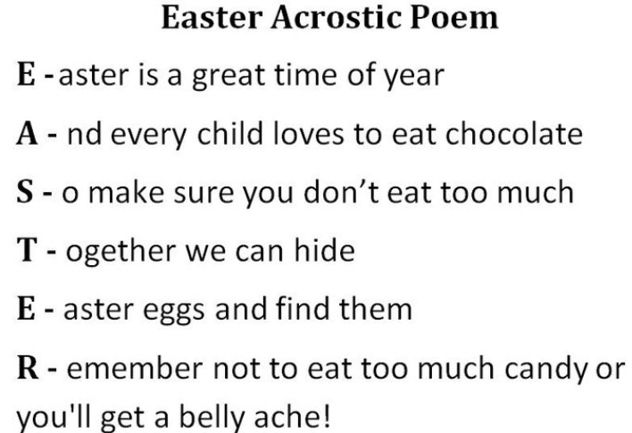
Acrostic

Slide 13
E-mails
Kakao talk
Posting comments on the Internet

