Slide 1
Chapter 9
Teaching speaking

Slide 2
Speaking activity 1
“If you were the person *** ,
who would you like to go out with?”

Slide 3
Speaking activity 2
Alibi game
Prof. Nam’s son is missing. It happened around 8 o’clock last night. She was at home. Your team members are suspects. You need to prove your alibis.

Slide 4
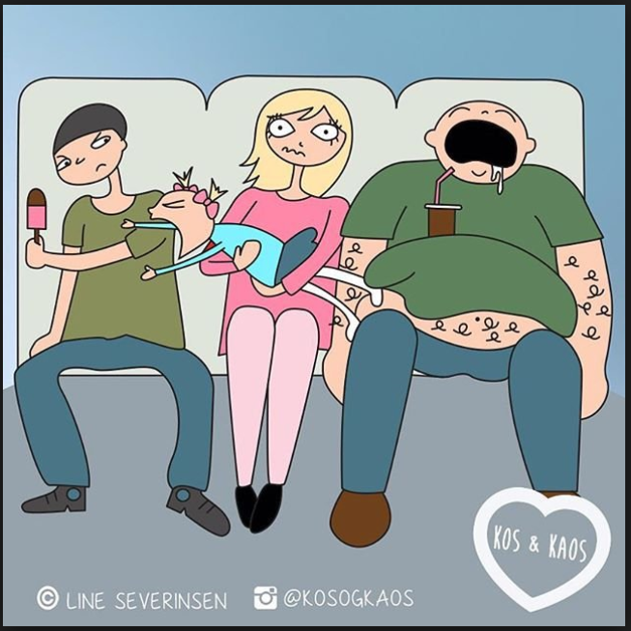
Speaking activity 3
A dialogue between the man and the woman

Slide 5
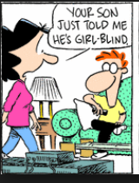
Speaking activity 4: Jigsaw activity
(only one member can see this picture)

Slide 6
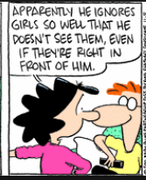

Slide 7
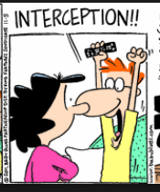

Slide 8
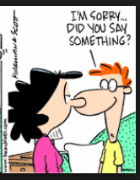

Slide 9
Speaking activity 5
Fortunately, Unfortunately
A fun, story telling game where players alternately add turn-for-the-worse and turn-for-the-better plot twists to the story. Seeing where these stories go is hilarious! No supplies needed!!

Slide 10
Speaking activity 6
Insert the words
Student A: humiliating, offer, spill
Student B: crush on, lend, hang out

Slide 11
Speaking activity 7
Debate

Slide 12
<Debate> When you want to agree with someone
You're right
I think so, too
I agree with you
You could be right
That's a good point
I couldn't agree more
I see what you mean
That's just what I was thinking
I agree entirely
You know, that's exactly what I think

Slide 13
When you want to disagree with someone
That's not the point
Yes, that's quite true, but_____
Well, you have a point there, but_____
Perhaps, but don't you think that_____
I see what you mean, but________
Don't you think it would be better...,
Shouldn't we consider...,
But what about...,
The truth of the matter is...,
The problem with your point of view is that...

Slide 14
Moral dilemmas
https://www.youtube.com/watch?v=bOpf6KcWYyw
https://www.youtube.com/watch?v=ssSIUVPjDns

